Slide 1


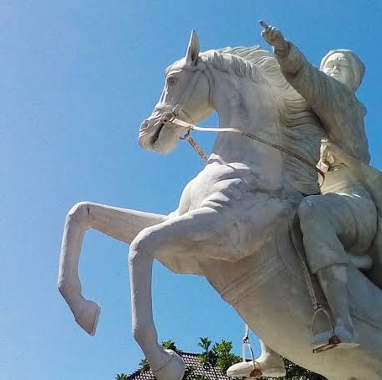



NEW STUDENT ADMISSION EPIDEMIOLOGY MASTER PROGRAM
DIPONEGORO UNIVERSITY
ONLINE CLASS DURING PANDEMIC
REGISTRATION
Phase I Odd Semester
Phase II Odd Semester April 24th- July 1st 2021
February 3rd - March 25th 2021
WHAT ARE YOU WAITING?
REGISTER SOON!
081328022588
Dr. drh. Dwi Sutiningsih, M.Kes
www.mep.pasca.undip.ac.id
epidemiologiundip@yahoo.com

Slide 2








REASONS WHY YOU HAVE TO CHOOSE
EPIDEMIOLOGY MASTER PROGRAM DIPONEGORO UNIVERSITY
DIPONEGORO UNIVERSITY
1 Has been accredited A by LAM-PTKes
2
Diponegoro International Student Scholarship (DISS)
is available (io.undip.ac.id/DISS)
Diponegoro Master Scholarship (DIMAS) is available (io.undip.ac.id/DIMAS)
4
SEAOHUN Scholarship is available
(https://bit.ly/SEAOHUNscholarship)
024-8417008
081328022588
Dr. drh. Dwi Sutiningsih, M.Kes
www.mep.pasca.undip.ac.id
epidemiologiundip@yahoo.com

Slide 3
EPIDEMIOLOGY MASTER PROGRAM DIPONEGORO UNIVERSITY
DIPONEGORO UNIVERSITY
CONCENTRATION
1.General Epidemiology 2.Field Epidemiologiy 3.Clinical Epidemiology 4.OH-FETP (One Health-Field
Epidemiology and Training Program)
STUDENT ADMISSION
-S1 Multidisciplinary
-D4 Health Science (Pharmacy, Health Analysis, Obstetrics, Physiotherapy, etc)
REGISTRATION
https://www.um.undip.ac.id/ UM Registration
Phase I Odd Semester February 3rd – March 25th 2021 Phase II Odd Semester
April 24th – July 1st 2021
REGISTRATION FEES
Registration Rp 750.000 Matriculation (if necessary) Rp 3.500.000
SPI Postgraduate SPP/semester
Rp 8.000.000 Rp 9.000.000
PROGRAMS
By Course
By Research
International Class
024-8417008
081328022588
Dr. drh. Dwi Sutiningsih, M.Kes
www.mep.pasca.undip.ac.id
epidemiologiundip@yahoo.com

